Slide 1




Apache Footwear India Private Limited
The Cutting Material Management Report
APC
Report Presented
Presented by : Manohar-G ( APC-IT )
2025 July 28

Slide 2

🛠 Meeting Focus Areas
1
2
3
4
Average Cutting Line Stoppage & Future Goal To Be Implemented In Production
The Prototype For Cutting Material Management
Tracking Real Time Production and SAP Data & Suggestions To Departments
Thanks To Derek-yang Sir

Slide 3
Apache Footwear India Private Limited
Average Cutting Line Stoppage & Future Goal To Be Implemented In Production
APC
Report Presented
Presented by : Manohar-G ( APC-IT )
2025 July 28

Slide 4

Average Cutting Line Stoppage
📊 Average Downtime Analysis (Period: July 24, 2025 – Past 30 Days)
To evaluate average machine downtime trends across production lines within the last 30 days, focusing on the Cutting process at Factory APC.
Row Labels | Sum of DT Hours
AP2 | 18
AP6 | 36.75
AP7 | 8
AP8 | 8
Grand Total | 70.75
Future Goal To Be Implemented In Production
🔹 Strategic Vision :
To minimize overall equipment downtime and optimize productivity across APC lines.
🔹 Target Metrics :
📆 Next 3 Months : Reduce cumulative downtime to ≤ 30 hours.
📆 Next 6 Months : Sustain downtime below 10 hours across all APC lines.
To support the downtime reduction goal by implementing a 3-level data visualization prototype that enables faster and more informed decision-making.

Slide 5
Apache Footwear India Private Limited
The Prototype For
Cutting Material
Management Report
APC
Report Presented
Presented by : Manohar-G ( APC-IT )
2025 July 28

Slide 6

Organizational Workflow for Cutting Material Monitoring
Data Capture
BOM
Provides base material requirements.
Cutting Material Report
Input purchase data
Issue materials, verify stock
Purchase Team
Warehouse Team
Track Purchase Status
Warehouse stock data
Production
Check assigned POs start cutting only if fully ready escalate
Ensure BOM is accurate
validate material need
resolve errors
Track PO-wise readiness
material issues
escalate to teams
Planning Team
Plant In-charge
Line Supervisor
shares
Assigns
Top
Management
Sees high-level overview
View overall readiness %
material trends
Top Management
Cutting Material Report auto-syncs BOM,PURCHASE, WAREHOUSE, PLANNING AND PO DATA| Triggers alerts and tracks material readiness

Slide 7
Cutting Material Availability – Line Supervisor
Day
PO NO
2025/07/05
All
Status
Line
All
All
📋 Assigned Pos
5
✅ Ready to Cutting
3
❌ Not Ready
1
⚠ Escalated
1
PO Readiness List
Day | Line | PO NO | Article | Material Status
2025/07/05 | AP11CO5 | 1000042525 | Samba | ✅ OK
 |  | 1000042579 | Samba | ❌ Short
Check
Check
Material Checklist by PO
PO NO
By default the field takes short material status po in ascending order
1000042579
PO NO | Article | Material | Material Name | Required Qty | Available Qty | Shortage Qty | Status | Invoice | ETA
1000206709 | Samba | M001 | Material 1 | 125 | 125 | 0 | ✅ OK
1000206709 | Samba | M002 | Material 2 | 520 | 300 | 220 | ❌ Short | INV-MAT-20240620-0048 | 2025/07/05
Raise Escalations
PO NO
1000042579
Issue
Submit
Enter Issue
Request store verification
PO NO
Check
1000042579

Slide 8
Cutting Material Availability – Plant In-charge Dashboard
Date Range
Line
PO NO
2025/07/01
All
Plant
All
All
Status
All
📋 Total POs Today
28
✅ Fully Ready Pos
19
🚫 Shortage Pos
7
🔁 Delayed Pos
2
PO-Wise Material Readiness Status
Date | PO NO | Model | Plant | Line | Material Readiness % | Status | Delay | Action
2025/07/02 | 1000042579 | SAMBA | AP11 | AP11C02 | 100% | ✅ Ready | - | Start Cutting
 | 1000042525 | STANSMITH | AP10 | AP10C04 | 75% | ❌ Short | 1 DAY | Escalate
 | 1000215486 | ULTIMATE | AP09 | AP09CO3 | 90% | ⚠ Partial
Check
Material Shortage Tracker
Material Name | Required Qty | Available Qty | Short Qty
Fabric A | 200m | 160m | 40m
Purpose: Core operational view—monitor each PO’s readiness at the line level and Material-wise breakdown of what’s short and how many POs are impacted..
Benefits : Take immediate steps for POs with issues and Communicate to purchase team or prioritize allocation from existing stock.

Slide 9
Cutting Material Availability Dashboard – Plant In-charge Dashboard
Critical Escalated Pos :
PO NO
Plant
Status
All
All
All
Submit
PO NO | Plant | Shortage | Delay | Escalated To | Status
1000042525 | Plant B | Fabric A | 3d | Planning Team | ⚠ Pending
1000042579 | Plant E | Material 2 |  | Purchase Team | ✅ Resolved
1000042587 | Plant H | Material 3 |  | Warehouse Team | ✅ Resolved
1000042592 | Plant K | Material 4 |  | Planning Team | ✅ Resolved
1000042466 | Plant F | Material 9 | 5d | Purchase Team | ⚠ Pending
Purpose: Highlight urgent POs that are delayed due to material unavailability and require attention.
Benefits : Spot improvement or decline in readiness over time. A dropping trend might signal deeper issues in supply or coordination.
Explanation For KPI Cards
Purpose: Give an instant overview of today’s key metrics
KPI | Description
📦 Material Readiness % | % of POs for which all required materials are 100% available. Shows overall cutting readiness.
🚨 Open Escalations | Total number of escalated cases (shortage or delay) not yet resolved. Reflects risk and follow-up need.
📋 Total POs Today | Number of POs scheduled for cutting today. Shows daily load.
📈 Average Delay | Average days of delay for POs with shortages. Helps GM assess the severity.
Benefits : Quick health check of plant’s material readiness and performance for the day.

Slide 10

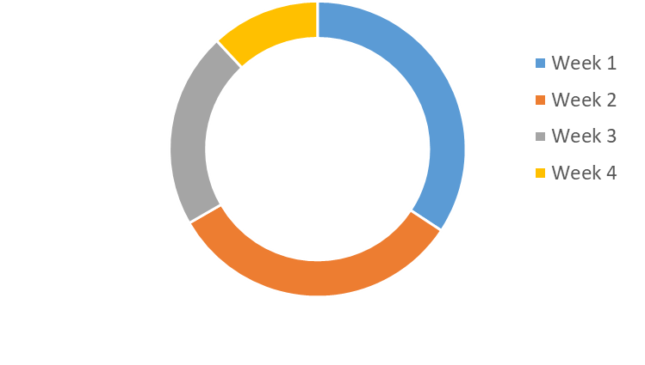
Cutting Material Availability Dashboard – Top Management
Date Range
Plant
2025/07/01
All
Line
Submit
All
📦 Material Readiness %
82% Ready
🚨 Open Escalations (issues not yet resolved)
5
📋 Total POs Today
36
📈 Avg Delay
2.1 days
Purpose: Compare different plants to see which ones are better prepared for cutting.
Description : Shows % of material availability across all assigned POs
Benefits : Identify which plant is performing well and where attention or escalation is needed.
Top 5 Short Materials :
Material | Short Quantity | Affected Pos
FTWR WHITE 01F7 54 | 340m | 3
1.4MM ECO SOFT MATTE | 220m | 8
CEMENT TWICE | 165m | 21
WHITE LATEX | 100m | 4
ST-A990-06E EPM5 MESH | 92m | 1
Purpose: Highlight the most frequently short or unavailable materials, across all POs.
Benefits : Quickly identify which raw materials are causing the biggest disruptions—helps guide procurement priorities
Cutting Availability Trend ( Weekly ) ( Line Wise )
Purpose: Visualize the trend of material readiness over time
Benefits : Spot improvement or decline in readiness over time. A dropping trend might signal deeper issues in supply or coordination.

Slide 11
Apache Footwear India Private Limited
APC
Track Real Time Production Data And SAP Data
Report Presented
Presented by : Manohar-G ( APC-IT )
2025 July 28

Slide 12
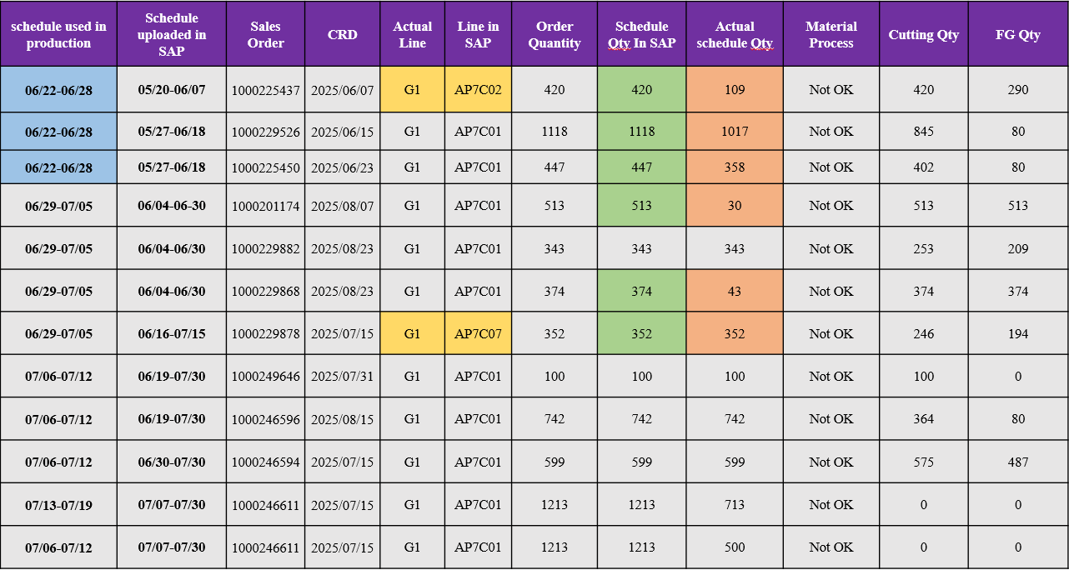
The Schedule Data For One Line
Reschedule Pos :
Rescheduled pos and notice pos are also not yet updated in the SAP system.
Late Schedule :
Schedules are uploaded late in SAP, which leads to misalignment with production CRD.
Line Mismatch Schedule :
There is a discrepancy between the actual schedule dates and Line followed in production and the schedule dates and LIne maintained in SAP, leading to misalignment in material planning and execution.
Schedule Quantity Mismatch :
There is a discrepancy between the actual schedule Qty followed in production and the schedule Qty maintained in SAP, leading to misalignment in material planning and execution.

Slide 13
Material Tracking For schedule PO -- 1000225437
Sales Order | Material | Material Name | Total Dosage Qty | Material Fetching sheet | Required Qty | Issued Qty | Un-issue Qty | Fetching create date | Fetching Issue Date
1000225437 | 4040300019 | NEW SIZE LABEL 25.4X28MM | 840 | - | - | - | - | - | -
 | 4040402339 | 65X22MM (MESH HEAT TRANSFER) | 164 | - | - | - | - | - | -
 | 4040402288 | 59X20.5MM (MESH HEAT TRANSFER) | 676 | - | - | - | - | - | -
 | 3100195320 | LETO SUEDE RC 100+FA 7100 P TPU | 2.511 | C102770862 | 2.512 | 2.512 | 0 | 2025/05/20 | 2025/05/23
 | 3100195232 | BETA MATTE RE5 TPU+FA 7100 P TPU | 0.5460 | C102770868 | 0.551 | 0.362 | 0.189 | 2025/05/20 | 2025/05/31
 | 3100195001 | YH-M1093+FA 7100 P TPU | 15.8608 | C102770864 | 15.863 | 15.863 | 0 | 2025/05/20 | 2025/05/22
 | 4040100097 | T50(50KG) | 5.867 | C102777629 | 5.871 | 5.871 | 0 | 2025/05/23 | 2025/05/31
 | 3100195267 | 0.7MM QUEEN TEX HY-100+012 25C DC R45 | 6.91350 | C102777626 | 6.917 | 6.917 | 0 | 2025/05/23 | 2025/06/03
 | 3100189294 | DJT 2836 JC MESH III+TOP:Ortholite lazy | 9.77311 | C102777626 | 9.776 | 9.776 | 0 | 2025/05/23 | 2025/06/03
 | 4030500497 | 1.0MM B15 HMT NON WOVEN | 5.314 | C102777624 | 5.318 | 5.318 | 0 | 2025/05/23 | 2025/05/31
 | 4040708467 | 23BYE02 WOVEN TAPE 18MM | 26,865.200 | C102770865 | 293.812 | 293.812 | 0 | 2025/05/20 | 2025/05/23
BOM Created but No Fetching :
Materials: 4040402339, 4040402288
Root Cause: BOM planned but purchase not triggered, leading to delay in production readiness.
Issues in Fetching :
Materials: 3100195232
Root Cause: Purchase completed, but material not fetched or errors in issuance (highlighted in red).
Very High Total Dosage Quantity:
Material: 4040708467 (26,865.200 dosage for just 951.129 requirement)
Root Cause: Likely a BOM error—dosage quantity too high for the required qty. Needs rechecking of BOM accuracy.
Delay In Fetching Issue Process :
There is a delay in the fetching process — fetching is being done two or more days after the creation date, which affects timely material availability and process flow.

Slide 14
Key Responsibilities For Cutting Material Management Report
BOM Department – Enhancing Accuracy and Efficiency :
1 . Ensure Accuracy in BOM Pulling
2 . Create BOM Based on Actual Article Usage 3 . Avoid Unnecessary Material Creation
Pull BOM
Planning Department – Driving Accurate Schedules and Coordination
Maintain Accurate Planning Data
Update Schedules Promptly
Coordinate Closely with Other Departments
Escalate Issues Proactively
Planning Department
Purchase Department – Ensuring Timely and Aligned Procurement
Procure Based on Finalized BOM Requirements
Monitor Material Lead Times Proactively
Avoid Over-Purchasing or Excess Inventory
Purchase Department
Warehouse Department
Warehouse Department – Maintaining Data Accuracy and Stock Readiness
Ensure Accurate Stock Data Maintenance
Fetch and Share Stock Data Correctly
Support Cutting Material Availability Checks
Production Department – Ensuring Smooth Execution and Timely Output
Follow Updated Cutting and Production Plans
Communicate Line Stoppages Immediately
Track and Share Real-Time Progress
Production

Slide 15

Thank You Derek-yang Sir For Your Valuable Guidance
We would like to extend our sincere thanks to Derek Sir for his valuable guidance, continuous support, and collaborative efforts throughout the review process.
His insights and leadership have played a key role in helping us identify the core issues and shape the direction for improvement.
We look forward to your continued involvement in our initiatives.

Slide 16




